Slide 1







Ticket4Sale
Where tickets never go to waste

Slide 2
Introduction
Tickets4Sale is an application created for Android Devices that gives users a marketplace designed specifically for tickets to events :
It provides a list containing all the different tickets added to the application to give the user an overview of what he can find.
Facilitates the communication between users through a built-in chat room.
Gives the option to filter the results for category, city or by searching the event name.
Provides different Log-in/Sign-in options to best fit the user preference

Slide 3



Let’s take a look at the application

Slide 4





The App
The Chatroom
TABLE OF CONTENTS
Database & Authentication
Other Features
The application and its features.
The Chatroom implementation.
Other cool features.
The structure and how it works.

Slide 5
01
The App
The main features of our application.

Slide 6
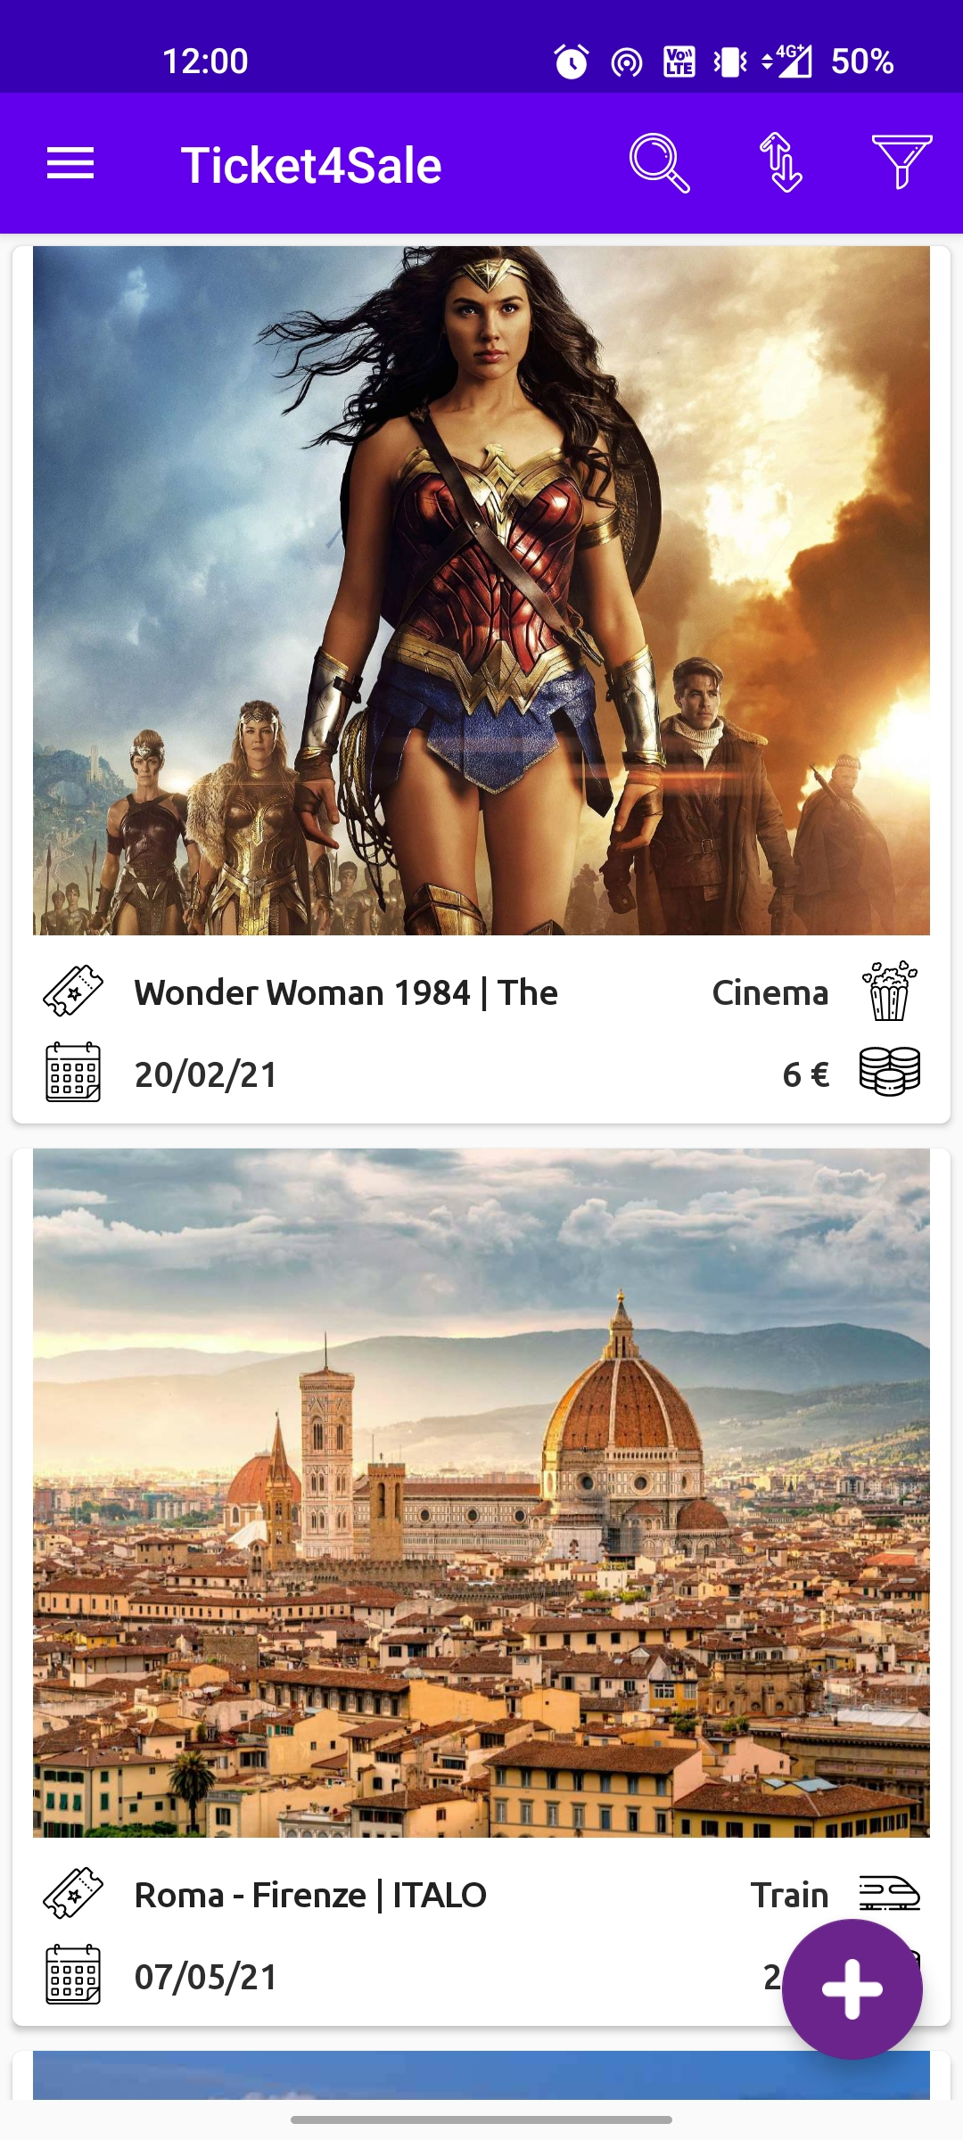
HOME
The home page shows a list of all avaible tickets in a Recycle View.
Here the user can :
Search by event name.
Filter by Category, Region and City
Order by insert date
Then he can select an event that catches his attention.

Slide 7
The Ticket
Ticket Information
The Layout
Once the user finds the event he was looking for, with a single tap he will see all the information he needs.
In this activity we have a Swipe layout with a collapsible toolbar to show the info in the best way.

Slide 8

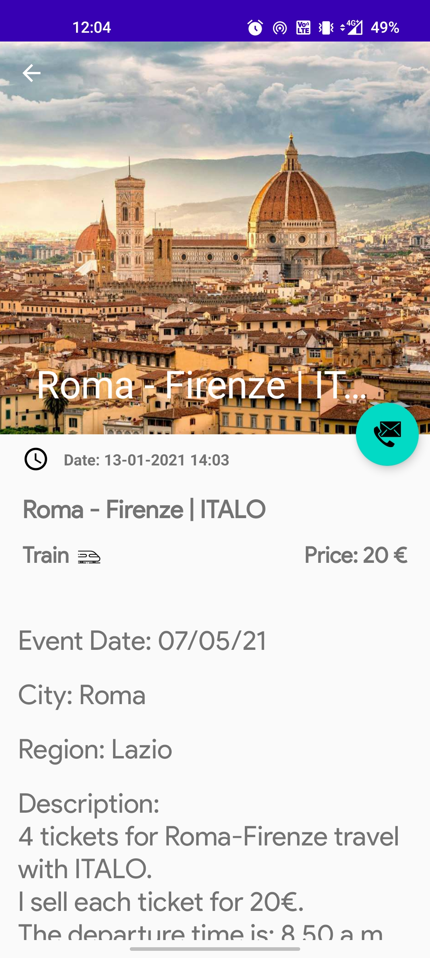
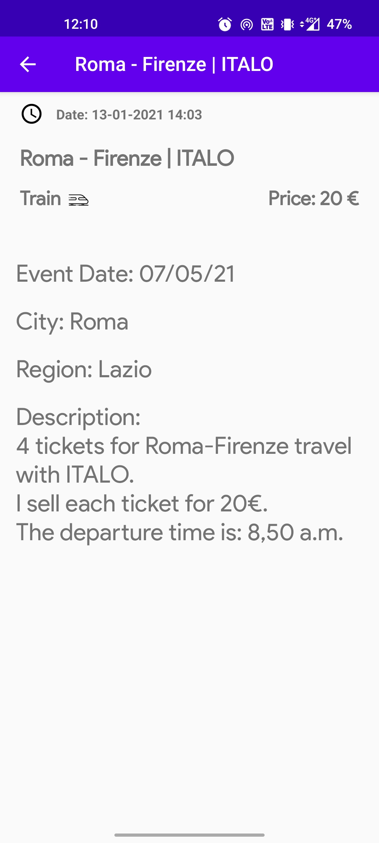
Ticket Information

Slide 9
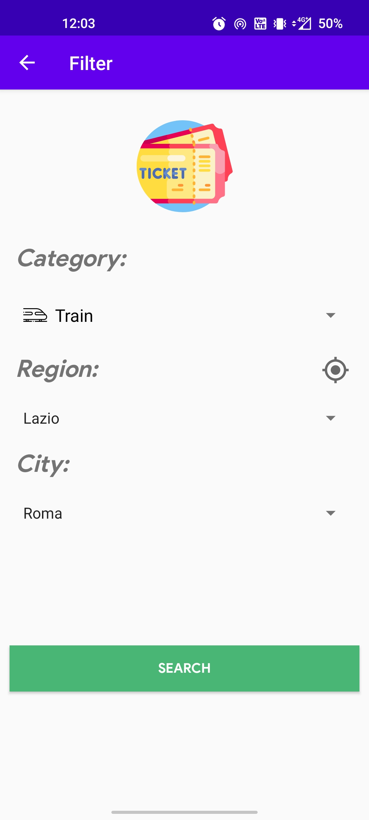
Filter and Search
The user can also use the filter and search functions to find with more ease the event he’s looking for.
The result of the function will be shown in a page analogous to the home view.

Slide 10
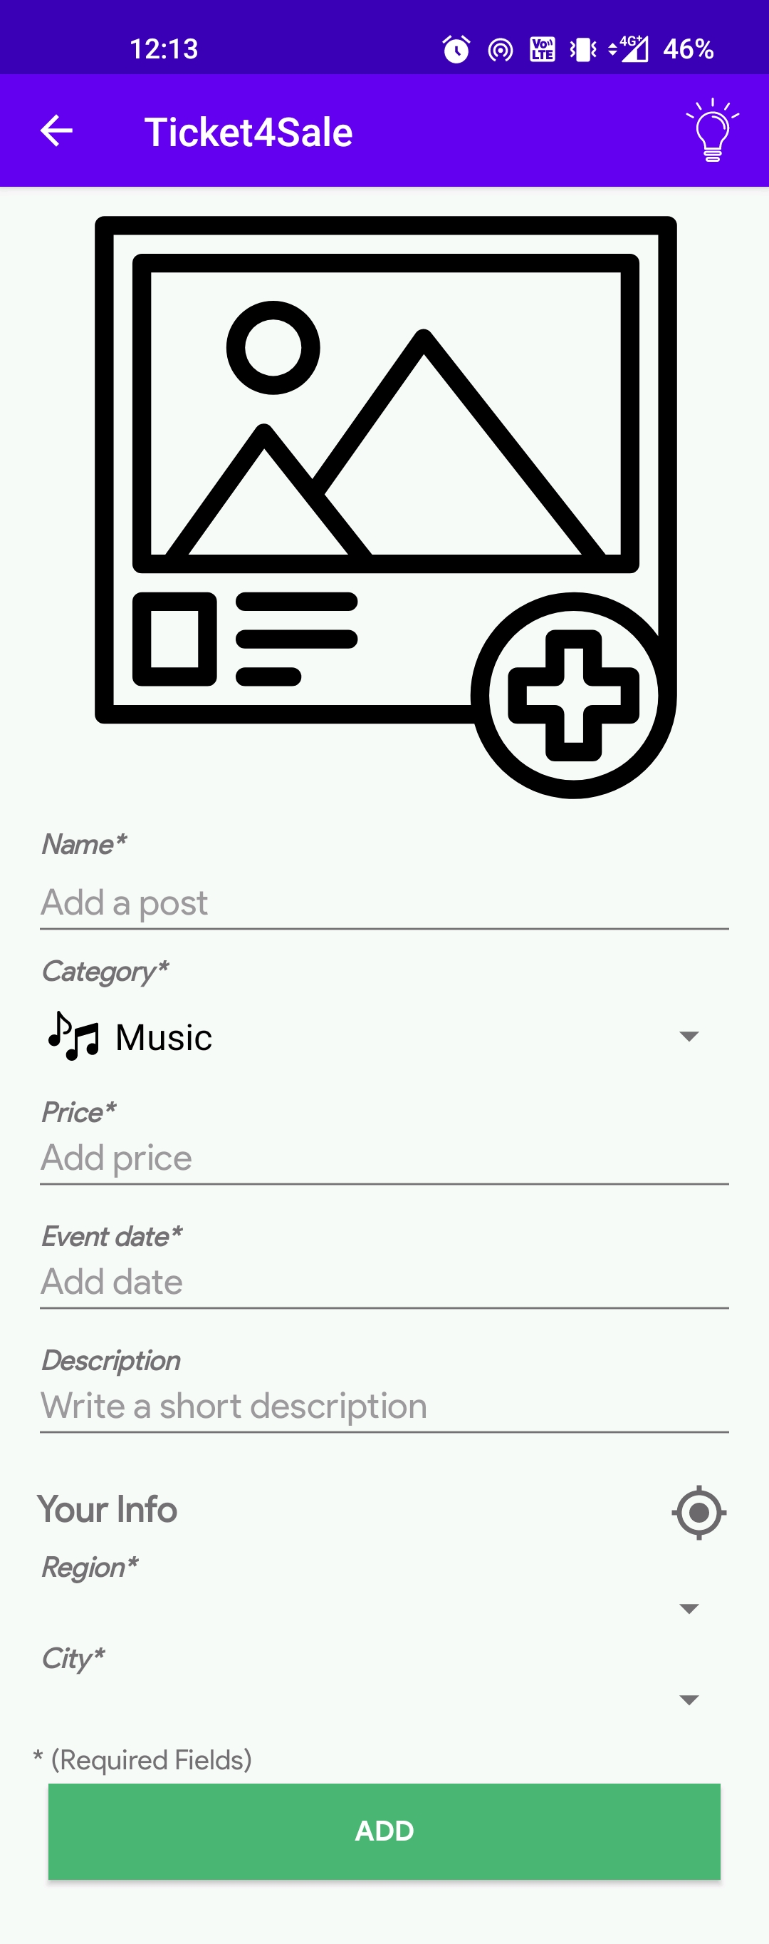
Add a ticket
To add a ticket to the database the user can easily tap the floating button and fill in the event information.
Most fields are required and return an error if not filled; also we added a function to retrieve Region and City through the device’s GPS.

Slide 11
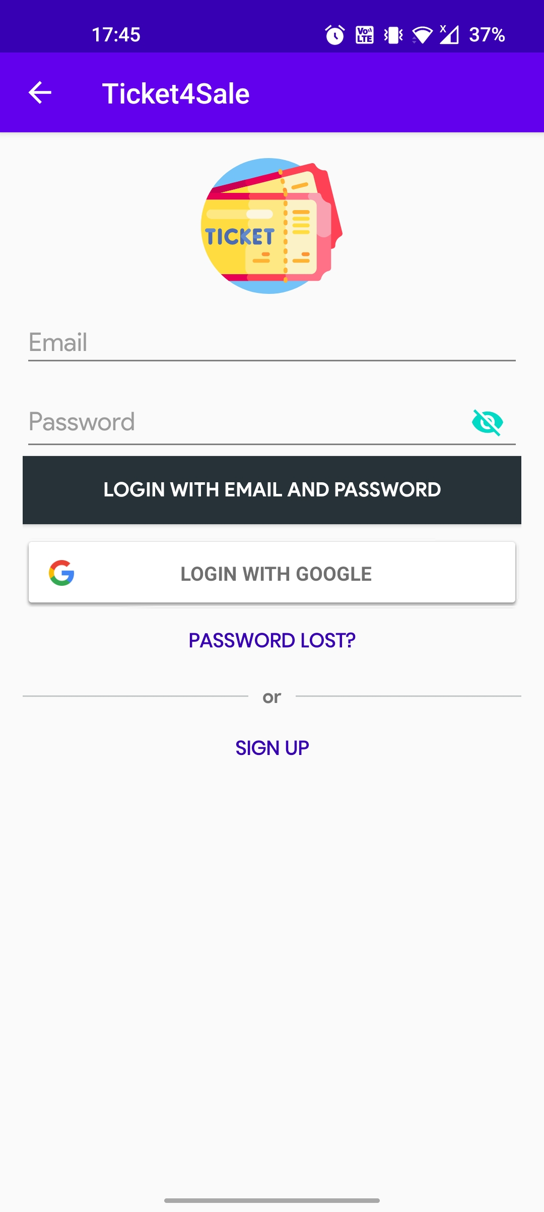
Log-In Options
We also wanted to give the user different options when they need to log-in; so we implemented the Google Sign-In Option

Slide 12
Logged-in User
Logged User
Once the user is logged-in, several new functions are available; such as the list of submitted tickets or the possibility to see or edit the user profile.

Slide 13
02
Database & Authentication
How the database is structured and accessed

Slide 14
The Database
To store all the ticket entries and all registered users we decided to use the free cloud database Firebase
Firebase Realtime Database is a cloud-hosted database. Data is stored as JSON and synchronized in real-time to every connected client. When you build cross-platform apps with our iOS, Android, and JavaScript SDKs, all of your clients share one Realtime Database instance and automatically receive updates with the newest data.

Slide 15
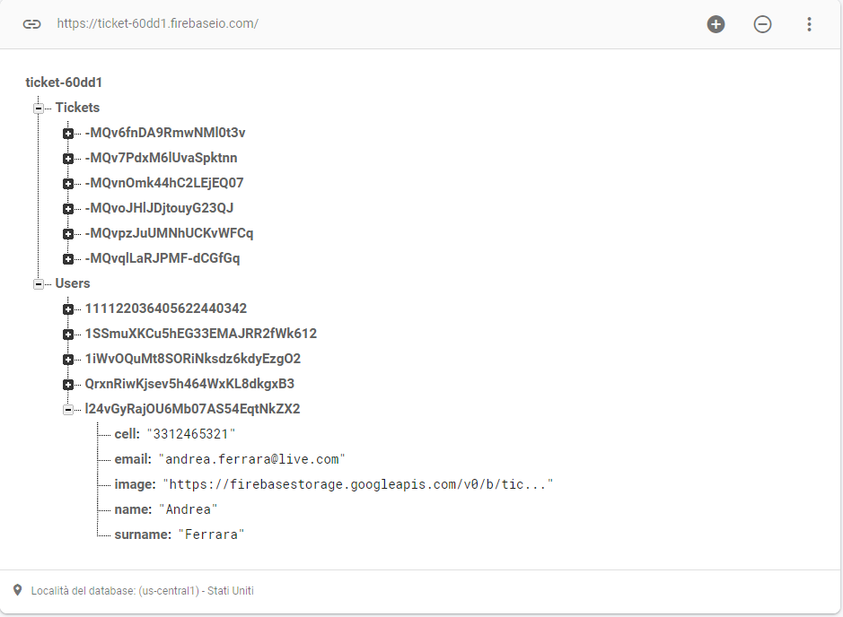
The Structure
The Database has two main tables; one for all the registered users to the application and one for the tickets which they added.
Each entry has obviously several attributes that form the object we want to store. Note that, for security reasons, we do not store in the database the users’ password.

Slide 16
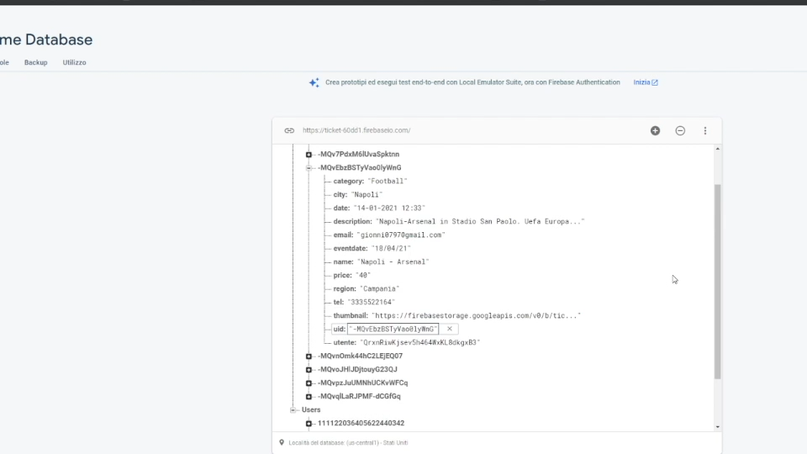
Edit and Delete Functions
Let’s see an example of how the Edit and Delete function work in the application and how they affect the database in real-time

Slide 17
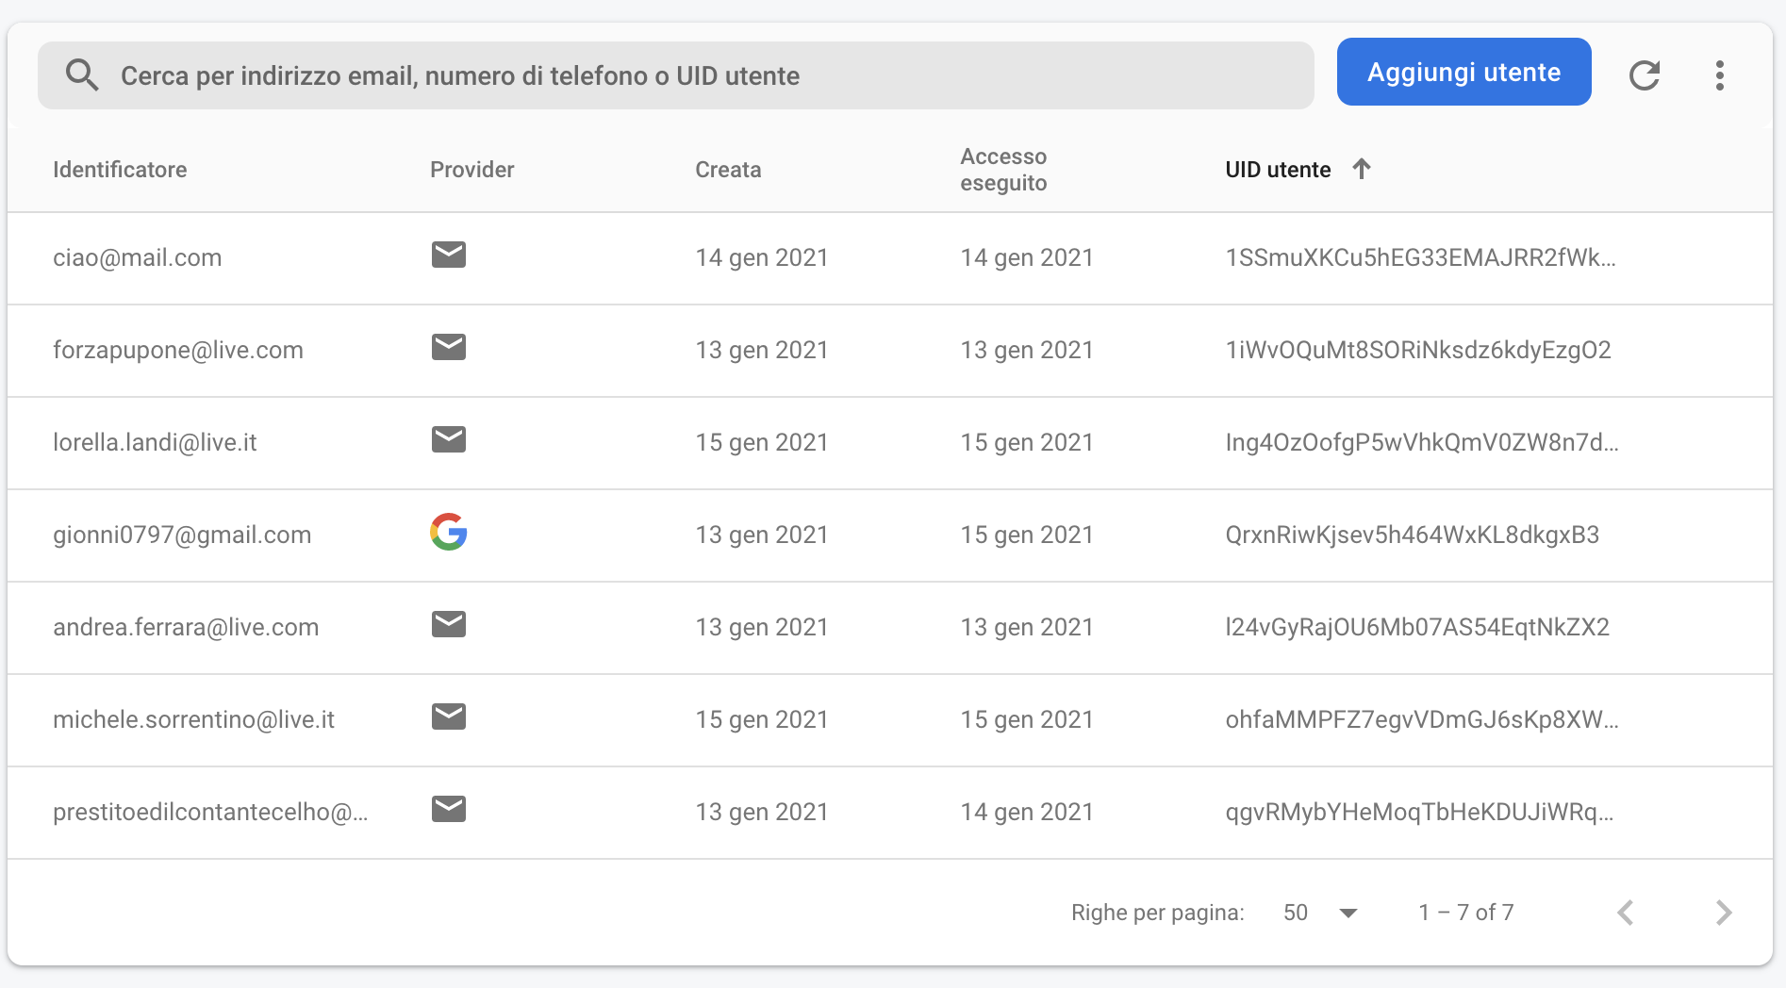
The Authentication
Firebase Authentication provides backend services, easy-to-use SDKs, and ready-made UI libraries to authenticate users to our app. It supports authentication using passwords, phone numbers, popular federated identity providers like Google, Facebook and Twitter, and more.
In our case we decided to authenticate the users via mail and password or via Google login.

Slide 18
03
The Chatroom
The implementation of a chatroom via WebSocket

Slide 19
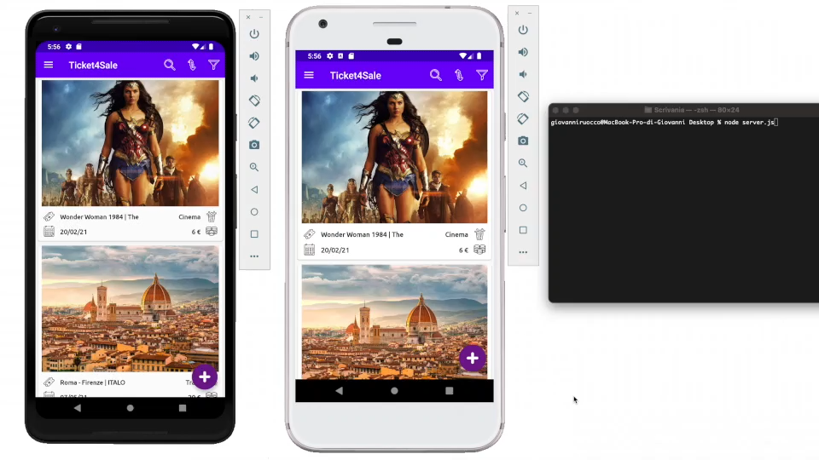
The Chatroom
The chatroom was implemented via WebSocket and was created to give the users a place where they can get to an agreement about a ticket or just to have an interesting talk with others movie entusiasts perhaps.
They only need to get authenticated via log-in and then jump right into it!

Slide 20
04
Other Features
Other interesting features of the application

Slide 21
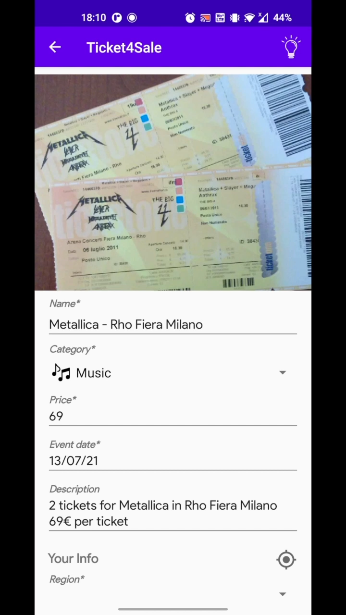
GPS
GPS Function
We implemented a GPS function to allow users to automatically fill the Region and City Fields.
It requires the user to grant the app the permission to access the device’s GPS.

Slide 22

Shake
Shake Function
As suggested by the hint (shown by tapping on the lightbulb icon), with a simple shake motion of the device all data will be cleared without having the user do it manually.

Slide 23
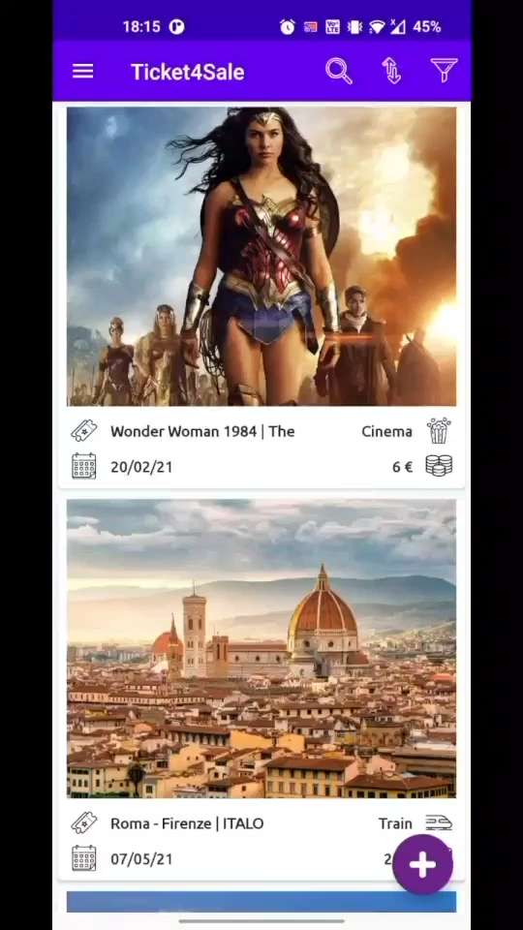
PayPal
PayPal API Integration
Using the PayPal API we created a Sandbox account to simulate the usage in a real-world environment.
Tapping on the Cheers! button in the NavBar the PayPal Activity is displayed

Slide 24

THANKS!
Giovanni Ruocco 1891327
Andrea Gaetano Ferrara 1887505
Engineering In Computer Science
Sapienza University, Rome

